Slide 1
Involving local people in the work of the Cancer Population Board
Thursday 30 March 2023

Slide 2
Recording
We are recording this session so that we can share the discussion with people who can't attend today's workshop.
Please feel free to switch off your camera if you don't want to be included on the recording.
It will be available on the Cancer Population Board page of the Leeds Health and Care Partnership website shortly.

Slide 3
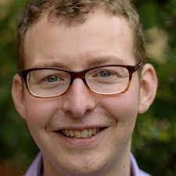
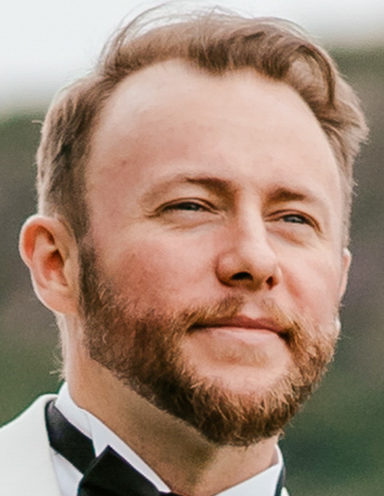
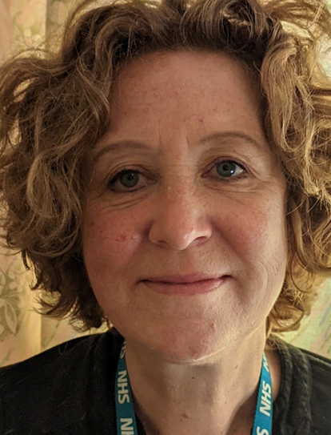
Welcome and introductions
Steve Bradley
GP, Researcher and Chair
of the Cancer Population Board
Tom Daniels
Pathway Integration Leader (Cancer and Diagnostics)
NHS Integrated Care Board in Leeds
Ross Lavery
Citizen / patient representative on the Cancer Population Board
Caroline Mackay
Community Relations and Involvement Manager
NHS Integrated Care Board in Leeds

Slide 4
Aim and Outcomes of the workshop
Aim: To share and sense-check our plans for involving local people in the work of the cancer population board
Outcomes – by the end of the workshop you will have:
Had an introduction to the cancer population board
Had an introduction to Population Health
Had a chance to discuss the findings of the cancer insight report
Had a chance to discuss gaps in our findings so far
Had a chance to discuss the draft goals / outcomes for the cancer board
Had a chance to discuss public representation and assurance on the board

Slide 5
Agenda
Population Health – Population Health as an approach and an introduction to the cancer population board
Experiences of cancer - What do we already know about local people's experiences of cancer care, including families and carers?
Population outcomes - How do we want care to be different for people with cancer, and their families and carers?
Public representation and assurance – What does public representation look like on the board and how can we be assured that it's working?
Next steps - What happens next?

Slide 6
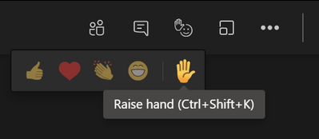
Ground rules
Stick to the agenda
Stay on mute unless you're speaking
Make space for everyone to speak
Have your say – use the hand signal or chat box to ask questions or share comments
Respect confidentiality
Enjoy the session!

Slide 7
The Population Health Approach Steve Bradley

Slide 8
Population health
Traditional approach - ‘commissioning’, ‘pathways’ & organisations
PH approach – focus on peoples’ needs & improving lives
Includes:
Prevention – helping people stay healthy
Outcomes – the differences services & support can make
Reducing health inequalities
Partnership working
The 'wider determinants of health'
Google: Kings’ Fund, What is a population health approach?
Notes:
As an approach, population health moves away from 'traditional' thinking about commissioning (planning and paying for) and providing health and care services.
It focuses less on organisations and pathways and more on the needs of the people, or populations, who use them.
It looks at:
The needs of people – what matters most to populations of people
Prevention – helping people stay healthy and well
Outcomes – the positive differences health care services and support can make
Reducing health inequalities
Working together in partnership rather than as individual organisations (system working)
The 'wider determinants of health' such as housing and transport

Slide 9
Population health (2)
Notes:
We aim to address these needs through a framework of nine population and two care delivery boards:
These boards are responsible for improving (or driving improvements in) the outcomes, experience, and the value of the NHS spend, for their respective population. They work across organisations and sectors with a clear focus on their population's particular needs.

Slide 10
Population health (3)
Notes:
We aim to address these needs through a framework of nine population and two care delivery boards:
These boards are responsible for improving (or driving improvements in) the outcomes, experience, and the value of the NHS spend, for their respective population. They work across organisations and sectors with a clear focus on their population's particular needs.

Slide 11
Population health (4)
Notes:
We aim to address these needs through a framework of nine population and two care delivery boards:
These boards are responsible for improving (or driving improvements in) the outcomes, experience, and the value of the NHS spend, for their respective population. They work across organisations and sectors with a clear focus on their population's particular needs.

Slide 12
Population health (5)
Notes:
We aim to address these needs through a framework of nine population and two care delivery boards:
These boards are responsible for improving (or driving improvements in) the outcomes, experience, and the value of the NHS spend, for their respective population. They work across organisations and sectors with a clear focus on their population's particular needs.

Slide 13
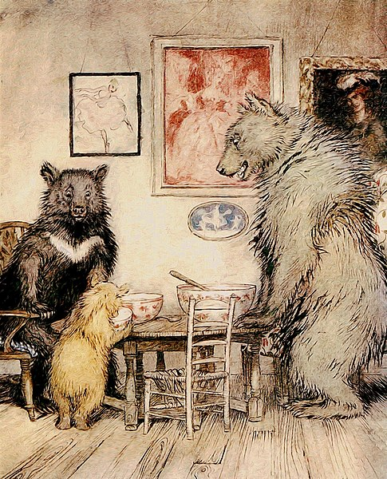
Getting boards “just right”
.
Broad enough (to represent all partners)
Senior enough (to take critical decisions)
Small enough (to make these decisions)
Arthur Rackham, from English Fairy Tales by Flora Annie Steel, 1918 (Project Gutenberg)
Notes:
Boards are made up of senior representatives from across the health and care partnership including representatives from the third sector and from Healthwatch Leeds.
There is also space for 'citizen' or people's voice representation, which we are thinking about today

Slide 14
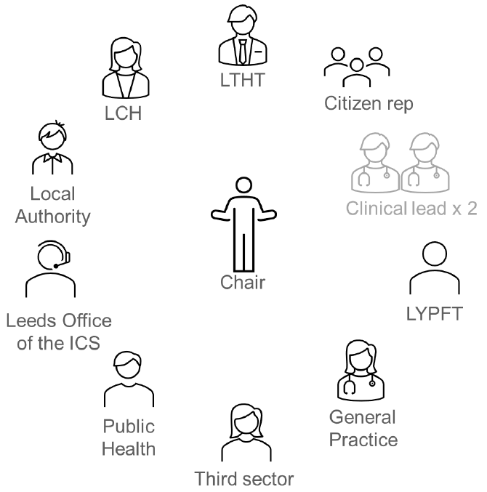
Make up of the board
Notes:
Boards are made up of senior representatives from across the health and care partnership including representatives from the third sector and from Healthwatch Leeds.
There is also space for 'citizen' or people's voice representation, which we are thinking about today

Slide 15
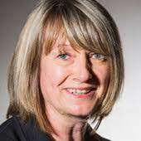
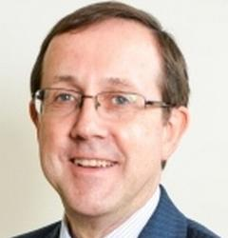
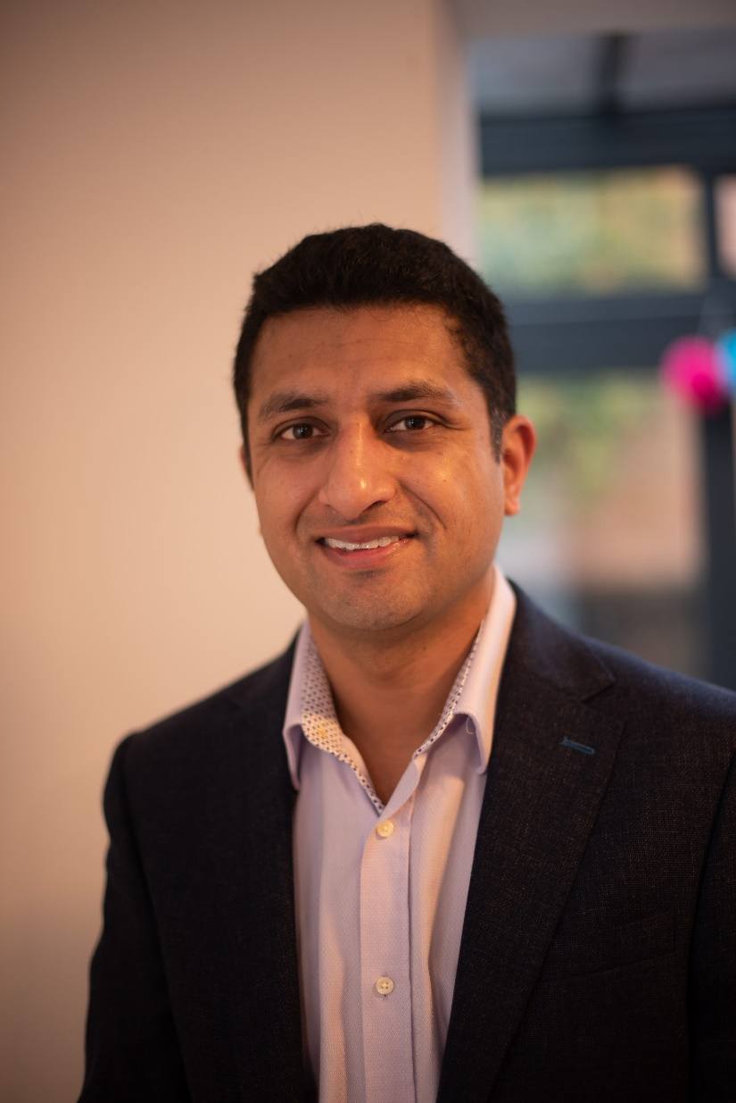
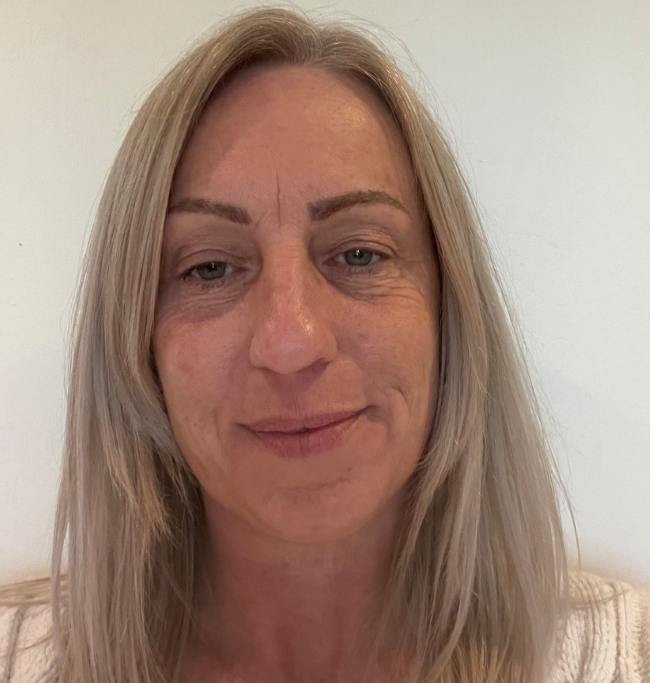
Who's on the board?
Fiona Stephenson, WY & Harrogate Cancer Alliance
Peter Lodge, LTHT
Karen Henry, LTHT
Tom Daniels, Leeds office of WY ICB
Stacey Taylor, Leeds office of WY ICB
Ross Lavery, patient representative (expert by experience)
Mitul Patel, GP
Notes:
Boards are made up of senior representatives from across the health and care partnership including representatives from the third sector and from Healthwatch Leeds.
There is also space for 'citizen' or people's voice representation, which we are thinking about today

Slide 16
Profiles
Carl Mackie - Representative for Leeds City Council, Public Health
More about me:
I have worked in Public Health in a variety of different roles and agendas for the last 19 years and I have been working in the Leeds system as Head of Public Health for Long term conditions and Cancer since 2020. My passion and interest is in influencing the wider determinants of health to improve health outcomes and reduce inequalities.
Stacey Taylor - Project Advisor in the Programme, Improvement and Integration (PII) Business Unit.
Representative of the Leeds Office of the ICB
More about me:
I have worked in the health and care system for over 20 years, working in housing associations, local authority, charities, and the 3rd sector.
I started working in the NHS in early 2022 within the PII business unit and my role is to bring partners and stakeholders together to work collaboratively in planning and delivering services to improve health outcomes for the people of Leeds.
Cancer is a new area that I have limited experience working in, having been affected by cancer I am really interested in early screening initiatives and diagnosis. I feel passionate about digital inclusion and peer support groups and services, having previously worked as a peer support coordinator for people living with a long-term condition, I'd be interested in getting involved in any cancer peer support plans.

Slide 17
Profiles (2)
My name is Ross Lavery. I am a 33 year old from Leeds.
My connection to this board is: I was diagnosed with Bowel Cancer after being rushed to hospital with a severe bowel blockage. I was told I had a few hours left to live unless I had immediate emergency surgery to remove my large intestine. I went to my GP multiple times over more than a year with severe digestive issues and was actively dismissed on each occasion. Despite saying I wanted to be tested for cancer I was denied, being told that the chances of cancer were so remote it wasn’t worth bothering and perhaps I should consider if I was a hypochondriac. After having 2 emergency, life saving surgeries I was left with a stoma and had to start chemotherapy as soon as possible (before I had a chance to adequately recover). 11 months later I had my stoma ‘reversed’ and I have been on the path to recovery since.
Main areas of interest:
● First point of contact – the patient-doctor relationship – building trust e.g. Better Conversations and the three C’s – Communication, Compassion and Coordination
● Moving on from treatment – recovery – ongoing support – hidden disability: ‘how do I get my life back on the other side?’

Slide 18
What kinds of decisions do we make?
How to bring different bits of the system together to get the best for people
How to work with other boards (managing overlap)
Discussing & supporting new initiatives
What can be done to address health inequalities
Notes:
It is essential that local people's views are included in these decision-making processes.
This workshop builds on what we have learned so far about people's experiences of living with frailty in Leeds, and gives us an opportunity to begin to think about what how we can involve people more moving forward.

Slide 19
Examples of things we’ve discussed
Results from patient experience survey
New ways to speed up diagnosis for possible prostate cancer
Trying to help find a way for an existing service to continue
An open access ‘chest x-ray service’ for people with symptoms
A service for some older people to tailor the right tests for suspected cancer
Better information for people with learning disability to help them take part in bowel screening

Slide 20
Experiences of cancer treatment and care - Using local people's experiences of cancer can help shape and improve cancer care in the future Caroline Mackay

Slide 21
Experiences of cancer treatment and care
The board is working with citywide partners to establish a developing evidence base of the needs and preferences of this population, to help make more informed decisions about their treatment and care.
The Leeds cancer insight report:
Outlines what we already know about people's needs, preferences and experiences of cancer treatment and care in Leeds
Identifies key themes and highlights what matters most to people, their families and carers
Highlights gaps in our knowledge or understanding

Slide 22
Experiences of cancer treatment and care (2)
The insight report highlights some key themes (1 of 2):
• Information – the need for timely and accessible information at all stages of people’s journeys through cancer treatment and care is a recurring theme in much of the insight.
It is also highlighted as being important in raising awareness, particularly in some of Leeds’ diverse communities where a lack of understanding about signs and symptoms of different types of cancer may mean people do not present as early as they could.
• Communication – as above, ongoing communication is mentioned as essential to keep people informed about their diagnosis, waiting times, treatment options and also, beyond treatment including in relation to options for peer and ongoing support.

Slide 23
Experiences of cancer treatment and care (3)
The insight report highlights some key themes (2 of 2):
• Health inequality – feedback from focus groups with members of diverse communities highlights the need to take into account multi-cultural beliefs about, and approaches to, cancer alongside the need to ensure information and communications are available in a range of formats and languages.
• Person-centred – the value of connecting with and hearing from others is emphasised, in the form of stories from other members of people’s own community and also as a means of direct support through, for example, peer support groups, especially once discharged from treatment.

Slide 24
Experiences of cancer treatment and care (4)
Gaps in what we know
In relation to gaps in our knowledge or understanding, this workshop is part of our work to learn from those with experience of cancer care or treatment about where we may need to do further work to learn more.
One gap we are aware of, is a lack of feedback from staff delivering and supporting cancer treatment and care.

Slide 25
Experiences of cancer treatment and care (5)
Discussion space
Do you agree with the main themes highlighted so far (information, communication, health inequality and person-centred care and support)?
What matters most to people?
What about gaps… where else should we be looking for insight, or who else should we be hearing from?

Slide 26
Population outcome measures – How will the board know it's making progress with its goals and ambitions? Tom Daniels

Slide 27
Population health – Cancer in Leeds
Cancer is the leading cause of death in the UK for males and females aged one and older. Cancer accounted for 28% of all deaths in the UK in 2019.
Every year in Leeds over 45,000 urgent suspected cancer referrals are made by Leeds GPs, with around 4,500 diagnoses of cancer. The most common cancers diagnosed in Leeds are lung, breast colorectal and prostate.
There are over 27,000 people in Leeds living with an active cancer diagnosis, and each year the health service spends just under £100m providing care for this population group.
The Cancer Population Board brings together partners from across the city to improve care, design more joined-up and sustainable cancer services and support, and make better use of public resources.
Webpage: https://www.healthandcareleeds.org/have-your-say/shape-the-future/populations/cancer/

Slide 28
Population outcome measures
Over the past year we have been working with our partners to agree a set of outcomes (or ambitions) for our cancer work in Leeds.
These outcomes explain what we as a board, and as a health and care partnership, want to achieve to improve the experiences of people receiving cancer treatment and care, and their families and carers.
The outcomes have been developed with healthcare service providers and voluntary sector organisations that work alongside people using cancer services and support.
The outcomes were shaped used patient, carer, family and staff feedback from various surveys and involvement activities.

Slide 29
Population outcome measures (2)
The outcomes for the board's cancer work in Leeds are:
More cancers will be prevented.
People with cancer in Leeds will be diagnosed earlier.
People will receive safe and effective cancer treatment.
People with cancer will receive person-centred care.

Slide 30
Population outcome measures (3)
We will use a range of measures to demonstrate our progress against these measures and to identify priorities. These include:
Prevention
% of people diagnosed with all cancers by age
% of people in Leeds who are smokers
% of people who with Body Mass Index (BMI) over 25
Early Diagnosis
% of people with cancer who are diagnosed at an early stage (stage one or two)
% diagnosed via 2ww referral vs proportion diagnosed via emergency presentation
Treatment
% of people each year who survive their cancer for five years or more
Patient Centred Care
Cancer Quality of Life Survey Results
Good quality of care reported in National Cancer Patient Experience Survey feedback
% of patients with completed cancer care reviews and end of treatment summaries

Slide 31
Population outcome measures (4)
Discussion space
Do these outcomes make sense to you?
More cancers will be prevented.
People with cancer in Leeds will be diagnosed earlier.
People will receive safe and effective cancer treatment.
People with cancer will receive person-centred care.
Do they reflect what matters to you / your family / the people you represent?

Slide 32
Public representation and assurance Making sure local people and their experiences of cancer treatment and care are at the heart of the board's work Caroline Mackay

Slide 33
Public representation and assurance
As an organisation, we have a legal and a moral duty to involve people in the plans and decisions we make about delivering healthcare in Leeds.
It's important that patients, carers and the wider public are aware, and assured, that we are working to ensure that people's voices and experiences are at the heart of our decision-making, and that people feel that their voices and experiences are being properly represented.
We need to be able to show that this is happening so that people can be assured that their input and feedback is helping shape and improve local services and support.
We call this providing 'public assurance'.

Slide 34
Public representation and assurance (2)
For people to feel assured we need to demonstrate we are:

Slide 35
Public representation and assurance (3)
There are various ways people's voice and experience can be taken into account by the board:
By an individual
By a sub-group which runs parallel to the board
By links with an existing group or organisation
By increasing feedback to services directly
Our work to strengthen public assurance is ongoing – today we are keen to hear your thoughts on how the voices and experiences of people living with frailty and their families and carers would be best represented at the board.

Slide 36
Public representation and assurance (4)
Discussion space
What would good public representation look like for you?
What would make you feel confident that we are listening, acting and feeding back?

Slide 37
Citizen / patient representation on the cancer board Ross Lavery

Slide 38
Introduction and links
Introduction to Ross – age 33, from Leeds - bowel cancer
Getting a diagnosis
Emergency presentation
Treatment
Recovery
Links with:
West Yorkshire and Harrogate Cancer Alliance
Yorkshire Cancer Community
Some connections to Macmillan and Maggie's

Slide 39
My experience on the cancer board
Invited to attend my first board meeting on 26th May 2022.
Role Outline
Due to my experience with the Cancer Alliance, I keep regular contact with many active and passionate cancer patients and advocates.
I have spent a great deal of my volunteered time listening to their stories and sharing experiences, all of who are passionate about continuing to improve care for future patients as well as maintain the areas of success.
As a result we all share that common drive for meaning and this community has had a larger positive impact through giving up their valuable time than they probably realise.
They are a valuable resource I hope is picked up on and used more widely in the future.
I am hopefully in a strong position as a result to share those perspectives of my fellow panel members and the stories I have heard from patients along my own journey.

Slide 40
My experience on the cancer board (2)
What's Working Well?
The speed and pace of actions and decisions is very reassuring. When working in this sort of group it can often feel like we are spinning wheels and not actually seeing any progress or change. It can sometimes feel like we are not reaching the ‘right ears’. This group of front line professionals and its continued progress in this board will be of genuine interest to my contacts.
What needs a bit more work?
Acronyms / insider terminology. Not just the medical jargon but also the NHS admin language that has developed within the organisation. I appreciate however that part of that learning is mine to do as well.

Slide 41
Final thoughts or questions
Any final thoughts or questions?

Slide 42
Next steps
We plan to add a copy of this recording to the cancer webpage:
https://www.healthandcareleeds.org/have-your-say/shape-the-future/populations/cancer/
We will send out the slides and an evaluation survey of this workshop
We'll use today's feedback to update the insight report where appropriate
We'll use today's feedback to help develop our approach to representation
We'll begin looking at the gaps in our knowledge and think about involving people to help us learn more. Please send any additional insight or comments to caroline.mackay2@nhs.net
We'll organise a follow-up public involvement meeting to talk more about public representation and assurance.

Slide 43
Thank you
Thank you for your time and your contribution – it's very much appreciated!

